Slide 1
CS 1678: Intro to Deep Learning Neural Network Basics
Prof. Adriana Kovashka University of Pittsburgh
January 22, 2024

Slide 2
Plan for this lecture (next few classes)
Definition
Architecture
Basic operations
Biological inspiration
Goals
Loss functions
Training
Gradient descent
Backpropagation
Hands-on exercise

Slide 3
Definition

Slide 4
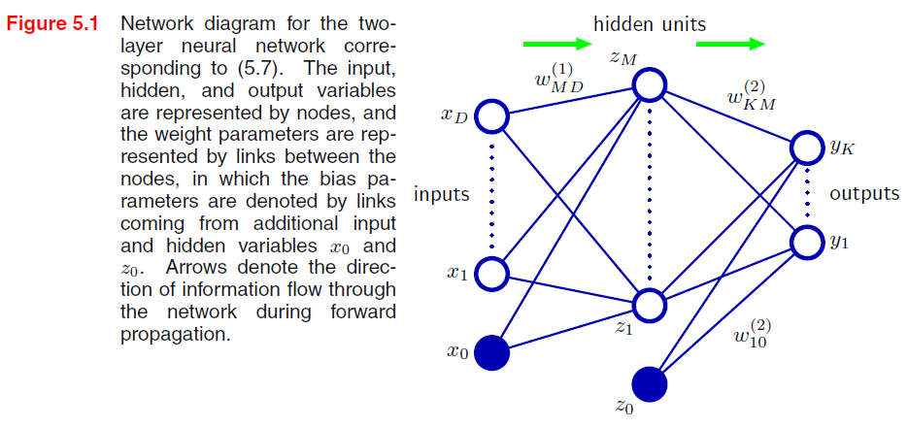
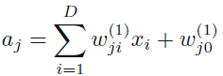
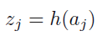
Neural network definition
Raw activations:
Nonlinear activation function h (e.g. sigmoid, tanh, RELU): e.g. z = RELU(a) = max(0, a)
Figure from Christopher Bishop
Notes:
w^T x + b = [sum_{i=1, ..., d} w_i * x_i ] + b
w: dx1 vector
x: dx1 vector
w' = [w; b] : (d+1)x1 vector
x' = [x; 1] : (d+1)x1
w'^T x' = w^T x + b

Slide 5
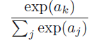
Neural network definition
Layer 2
Layer 3 (final)
Outputs
Finally:
(multiclass)
(binary)
(binary)

Slide 6
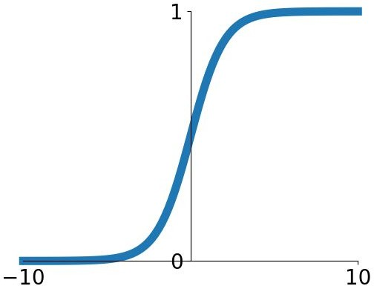
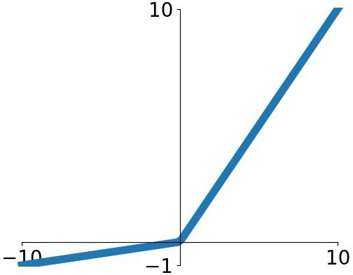
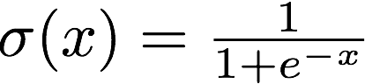
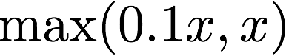
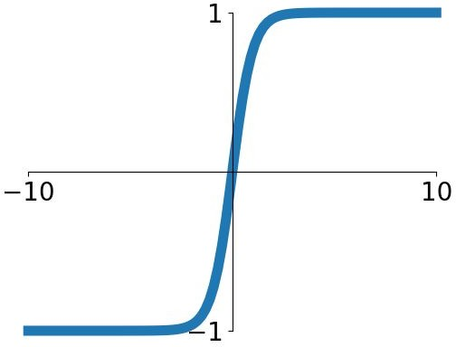
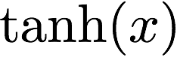
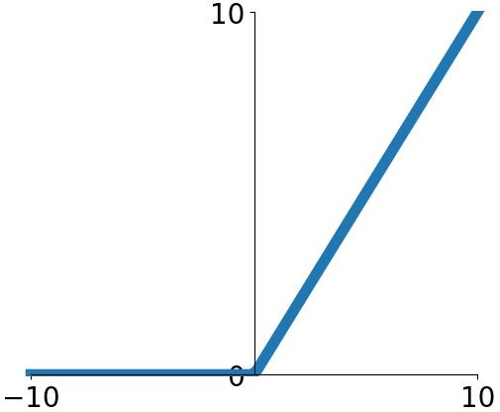
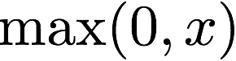
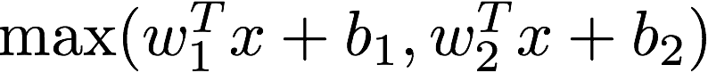
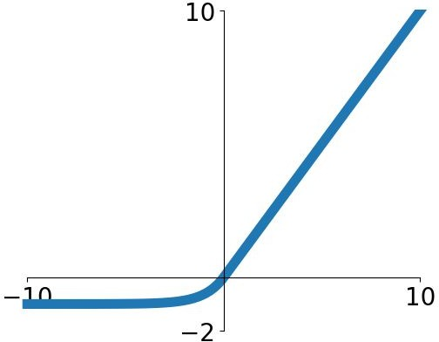
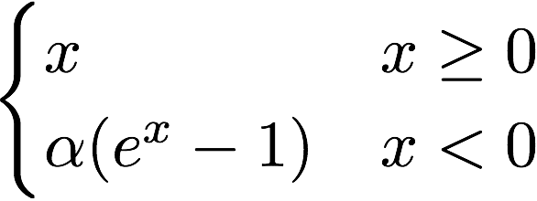
Activation functions
Sigmoid
tanh
Leaky ReLU
f(x) = x if x >= 0
f(x) = 0.1x if x <= 0
PReLU
a
ReLU
f(x) = x if x >= 0
f(x) = 0 if x <= 0
Maxout
ELU
Adapted from Fei-Fei Li, Andrej Karpathy, Justin Johnson, Serena Yeung

Slide 7
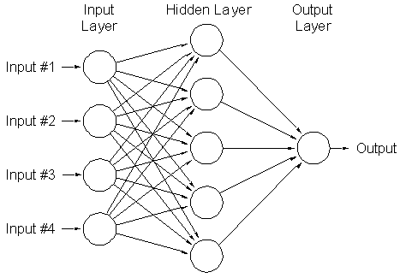
A multi-layer neural network…
Is a non-linear classifier
Can approximate any continuous function to arbitrary accuracy given sufficiently many hidden units
Lana Lazebnik

Slide 8


Inspiration: Neuron cells
Neurons
accept information from multiple inputs
transmit information to other neurons
Multiply inputs by weights along edges
Apply some function to the set of inputs at each node
If output of function over threshold, neuron “fires”
Text: HKUST, figures: Andrej Karpathy
Notes:
From Wikipedia: At the majority of synapses, signals are sent from the axon of one neuron to a dendrite of another... All neurons are electrically excitable, maintaining voltage gradients across their membranes… If the voltage changes by a large enough amount, an all-or-none electrochemical pulse called an action potential is generated, which travels rapidly along the cell's axon, and activates synaptic connections with other cells when it arrives.

Slide 9
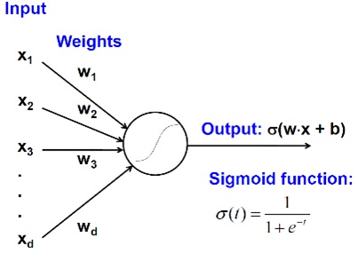
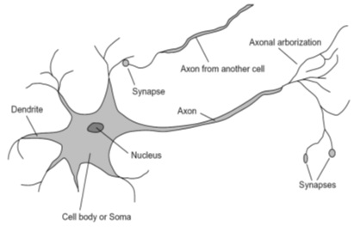

Biological analog
A biological neuron
An artificial neuron
Jia-bin Huang

Slide 10
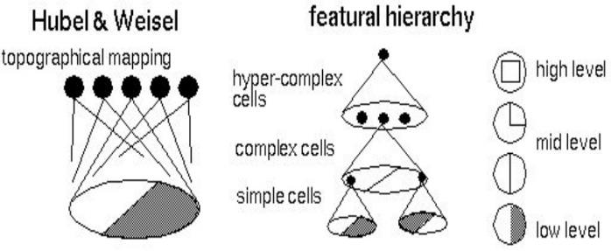

Biological analog
Hubel and Weisel’s architecture
Multi-layer neural network
Adapted from Jia-bin Huang

Slide 11
Feed-forward networks
Cascade neurons together
Output from one layer is the input to the next
Each layer has its own sets of weights
HKUST

Slide 12
Feed-forward networks
Inputs multiplied by initial set of weights
HKUST

Slide 13
Feed-forward networks
Intermediate “predictions” computed at first hidden layer
HKUST

Slide 14
Feed-forward networks
Intermediate predictions multiplied by second layer of weights
Predictions are fed forward through the network to classify
HKUST

Slide 15
Feed-forward networks
Compute second set of intermediate predictions
HKUST

Slide 16
Feed-forward networks
Multiply by final set of weights
HKUST

Slide 17
Feed-forward networks
Compute output (e.g. probability of a particular class being present in the sample)
HKUST

Slide 18
Deep neural networks
Lots of hidden layers
Depth = power (usually)
Weights to learn!
Weights to learn!
Weights to learn!
Weights to learn!
Figure from http://neuralnetworksanddeeplearning.com/chap5.html

Slide 19
Goals

Slide 20
How do we train deep networks?
No closed-form solution for the weights (can’t set up a system A*w = b, solve for w)
We will iteratively find such a set of weights that allow the outputs to match the desired outputs
We want to minimize a loss function (a function of the weights in the network)
For now, let’s simplify and assume there’s a single layer of weights in the network, and no activation function (i.e., output is a linear combination of the inputs)

Slide 21
Finding the optimal w: Example
Suppose w is just a scalar, w, that can only take values 1, 2, 3
Suppose L(w=1) = 2, L(w=2) = 5, L(w=3) = 0.5
Find the optimal w as argmin_w L(w)
What is the optimal w?
Now suppose L^(w) = L(w) + ||w||
L^(1) = 2+1 = 3
L^(2) = ? L^(3) = ?
Now what is the optimal w?

Slide 22
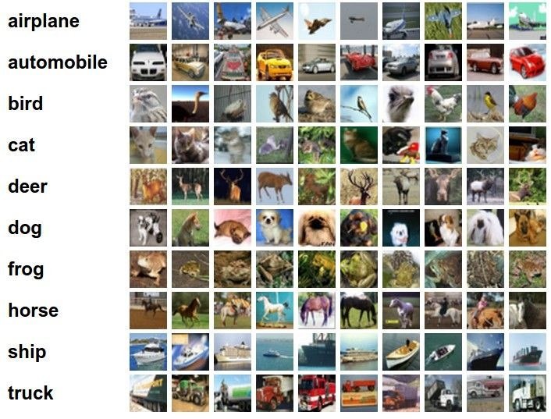
Classification goal
Example dataset: CIFAR-10 10 labels
50,000 training images each image is 32x32x3
10,000 test images.
Andrej Karpathy

Slide 23
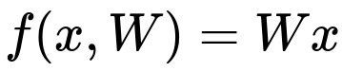

Classification scores
image
parameters
f(x,W)
10 numbers, indicating class scores
[32x32x3]
array of numbers 0...1 (3072 numbers total)
Andrej Karpathy

Slide 24
Linear classifier
3072x1
(+b)
10x1
10x1
10x3072
10 numbers, indicating class scores
[32x32x3]
array of numbers 0...1
parameters, or “weights”
Andrej Karpathy

Slide 25
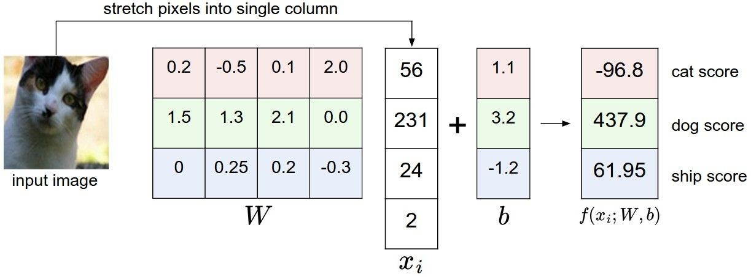
Linear classifier
Example with an image with 4 pixels, and 3 classes (cat/dog/ship)
Andrej Karpathy

Slide 26


Linear classifier
Going forward: Loss function/Optimization
TODO:
1. Define a loss function that quantifies our unhappiness with the scores across the training data.
cat car frog
3.2
5.1
-1.7
1.3
4.9
2.0
2.2
2.5
-3.1
2. Come up with a way of efficiently finding the parameters that minimize the loss function. (optimization)
Adapted from Andrej Karpathy

Slide 27
Linear classifier
Suppose: 3 training examples, 3 classes. With some W the scores
are:
cat car frog
3.2
5.1
-1.7
1.3
4.9
2.0
2.2
2.5
-3.1
Adapted from Andrej Karpathy

Slide 28
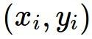
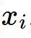
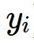
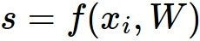
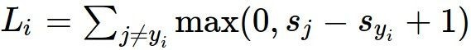
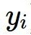
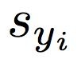
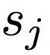
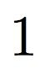
Linear classifier: Hinge loss
Suppose: 3 training examples, 3 classes. With some W the scores
Hinge loss:
Given an example
are:
where where
is the image and
is the (integer) label,
and using the shorthand for the scores vector:
cat car frog
the loss has the form:
3.2
5.1
-1.7
1.3
4.9
2.0
2.2
2.5
-3.1
Want: s_{yi} >= s_{j} + 1
i.e. s_{j} – s_{yi} + 1 <= 0
If true, loss is 0
If false, loss is magnitude of violation
Adapted from Andrej Karpathy

Slide 29
Linear classifier: Hinge loss
Suppose: 3 training examples, 3 classes. With some W the scores
Hinge loss:
Given an example
are:
where where
is the image and
is the (integer) label,
and using the shorthand for the scores vector:
the loss has the form:
cat car frog | 3.2 5.1 -1.7 | 1.3 2.2 4.9 2.5 2.0 -3.1
Losses: | 2.9
= max(0, 5.1 - 3.2 + 1)
+max(0, -1.7 - 3.2 + 1)
= max(0, 2.9) + max(0, -3.9)
= 2.9 + 0
= 2.9
Adapted from Andrej Karpathy

Slide 30
Linear classifier: Hinge loss
Suppose: 3 training examples, 3 classes. With some W the scores
Hinge loss:
Given an example
are:
where where
is the image and
is the (integer) label,
and using the shorthand for the scores vector:
the loss has the form:
cat 3.2 car 5.1 frog -1.7 | 1.3 4.9 2.0 | 2.2 2.5 -3.1
Losses: 2.9 | 0
= max(0, 1.3 - 4.9 + 1)
+max(0, 2.0 - 4.9 + 1)
= max(0, -2.6) + max(0, -1.9)
= 0 + 0
= 0
Adapted from Andrej Karpathy

Slide 31
Linear classifier: Hinge loss
Suppose: 3 training examples, 3 classes. With some W the scores
Hinge loss:
Given an example
are:
where where
is the image and
is the (integer) label,
and using the shorthand for the scores vector:
the loss has the form:
cat car frog | 3.2 5.1 -1.7 | 1.3 4.9 2.0 | 2.2 2.5 -3.1
Losses: | 2.9 | 0 | 12.9
= max(0, 2.2 - (-3.1) + 1)
+max(0, 2.5 - (-3.1) + 1)
= max(0, 5.3 + 1)
+ max(0, 5.6 + 1)
= 6.3 + 6.6
= 12.9
Adapted from Andrej Karpathy

Slide 32
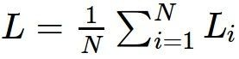
Linear classifier: Hinge loss
Suppose: 3 training examples, 3 classes. With some W the scores
Hinge loss:
Given an example
are:
where where
is the image and
is the (integer) label,
and using the shorthand for the scores vector:
cat car frog
the loss has the form:
3.2
5.1
-1.7
1.3
4.9
2.0
2.2
2.5
-3.1
and the full training loss is the mean over all examples in the training data:
L = (2.9 + 0 + 12.9)/3
Losses:
2.9
0
12.9
= 15.8 / 3 = 5.3
Lecture 3 - 12
Adapted from Andrej Karpathy

Slide 33
Linear classifier: Hinge loss
E.g. Suppose that we found a W such that L = 0. Is this W unique?
No! 2W also has L = 0!
How do we choose between W and 2W?
Slide from Fei-Fei, Johnson, Yeung

Slide 34
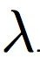
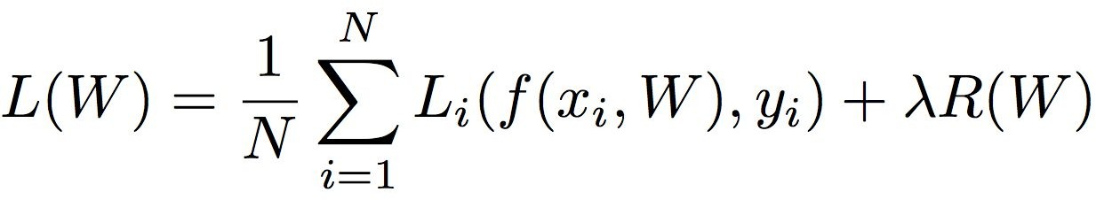
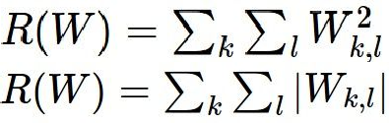
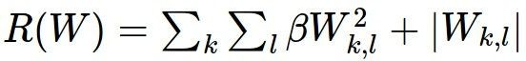
Weight Regularization
= regularization strength (hyperparameter)
Data loss: Model predictions should match training data
Regularization: Prevent the model from doing too well on training data
Simple examples L2 regularization: L1 regularization:
Elastic net (L1 + L2):
More complex:
Dropout
Batch normalization
Stochastic depth / pooling, etc
Why regularize?
Express preferences over weights
Make the model simple so it works on test data
Adapted from Fei-Fei, Johnson, Yeung

Slide 35
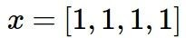
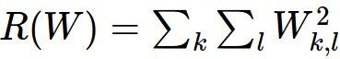
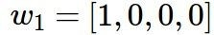
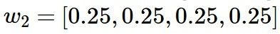
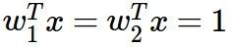
Weight Regularization
Expressing preferences
L2 Regularization
L2 regularization likes to “spread out” the weights
Slide from Fei-Fei, Johnson, Yeung

Slide 36
Weight Regularization
Preferring simple models
f₁
f₂
y
x
Regularization pushes against fitting the data
too well so we don’t fit noise in the data

Slide 37
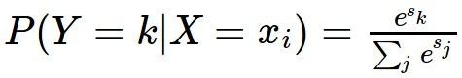
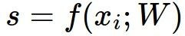
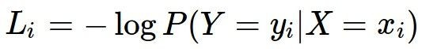
Another loss: Cross-entropy
scores = unnormalized log probabilities of the classes
where
cat car frog
3.2
5.1
-1.7
Want to maximize the log likelihood, or (for a loss function) to minimize the negative log likelihood of the correct class:
Adapted from Andrej Karpathy

Slide 38
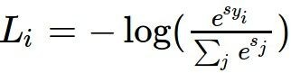
Another loss: Cross-entropy
Probabilities must be >= 0
Probabilities must sum to 1
cat car frog
3.2 5.1 -1.7 | exp
0.13
0.87
0.00
24.5
164.0
0.18
L_i = -log(0.13)
= 0.89
normalize
unnormalized log probabilities
probabilities
unnormalized probabilities
Aside:
- This is multinomial logistic regression
- Choose weights to maximize the likelihood of the observed x/y data (Maximum Likelihood Estimation; more discussion in CS 1675)
Adapted from Fei-Fei, Johnson, Yeung

Slide 39
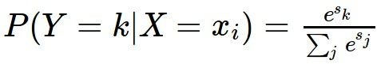
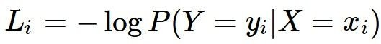
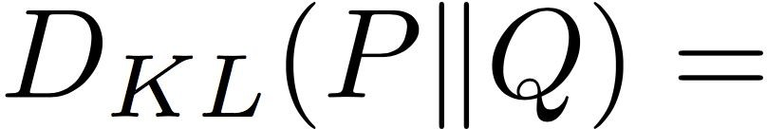
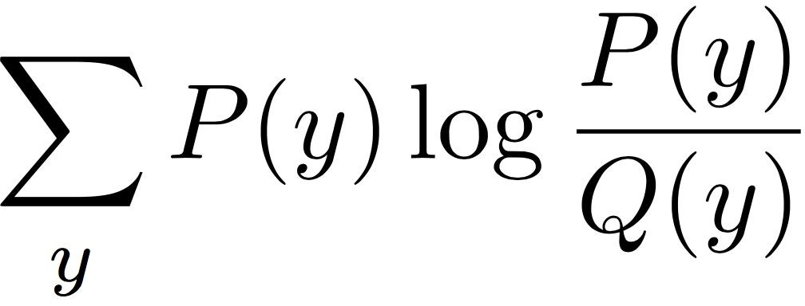
Another loss: Cross-entropy
Probabilities must be >= 0
Probabilities must sum to 1
cat car frog
3.2
5.1
-1.7
24.5
164.0
0.18
0.13
0.87
0.00
compare
 | 1.00
 | 0.00
 | 0.00
exp
normalize
Kullback–Leibler divergence
unnormalized
log-probabilities / logits
unnormalized
probabilities
probabilities
correct
probs
Adapted from Fei-Fei, Johnson, Yeung

Slide 40

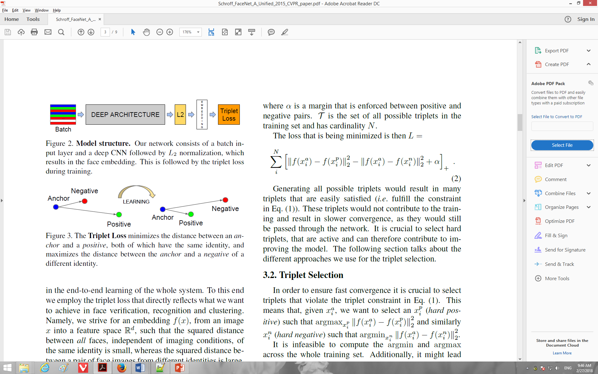
Other losses
Triplet loss (Schroff, FaceNet, CVPR 2015)
Anything you want! (almost)
a denotes anchor
p denotes positive
n denotes negative

Slide 41
Training

Slide 42


To minimize loss, use gradient descent
Andrej Karpathy

Slide 43


How to minimize the loss function?
In 1-dimension, the derivative of a function is:
In multiple dimensions, the gradient is the vector of (partial derivatives):
Adapted from Andrej Karpathy, definition/equation from https://en.wikipedia.org/wiki/Gradient

Slide 44


Loss gradients
Denoted as (diff notations):
i.e. how does the loss change as a function of the weights
We want to change the weights in such a way that makes the loss decrease as fast as possible

Slide 45
current W:
gradient dW:
[0.34,
-1.11,
0.78,
0.12,
0.55,
2.81,
-3.1,
-1.5,
0.33,…]
loss 1.25347
[?,
?,
?,
?,
?,
?,
?,
?,
?,…]
Andrej Karpathy

Slide 46
current W:
W + h (first dim):
gradient dW:
[0.34,
-1.11,
0.78,
0.12,
0.55,
2.81,
-3.1,
-1.5,
0.33,…]
loss 1.25347
[0.34 + 0.0001,
-1.11,
0.78,
0.12,
0.55,
2.81,
-3.1,
-1.5,
0.33,…]
loss 1.25322
[?,
?,
?,
?,
?,
?,
?,
?,
?,…]
Andrej Karpathy

Slide 47
current W:
W + h (first dim):
gradient dW:
[0.34,
-1.11,
0.78,
0.12,
0.55,
2.81,
-3.1,
-1.5,
0.33,…]
loss 1.25347
[0.34 + 0.0001,
-1.11,
0.78,
0.12,
0.55,
2.81,
-3.1,
-1.5,
0.33,…]
loss 1.25322
[-2.5,
?,
?,
?,
?,
?,
?,
(1.25322 - 1.25347)/0.0001
= -2.5
?,
?,…]
Logan note Compute loss and loss where one of the weights is increased by a small number find the diff and divide by the small number
Andrej Karpathy

Slide 48
current W:
W + h (second dim):
gradient dW:
[0.34,
-1.11,
0.78,
0.12,
0.55,
2.81,
-3.1,
-1.5,
0.33,…]
loss 1.25347
[0.34,
-1.11 + 0.0001,
0.78,
0.12,
0.55,
2.81,
-3.1,
-1.5,
0.33,…]
loss 1.25353
[-2.5,
?,
?,
?,
?,
?,
?,
?,
?,…]
Andrej Karpathy

Slide 49
current W:
W + h (second dim):
gradient dW:
[0.34,
-1.11,
0.78,
0.12,
0.55,
2.81,
-3.1,
-1.5,
0.33,…]
loss 1.25347
[0.34,
-1.11 + 0.0001,
0.78,
0.12,
0.55,
2.81,
-3.1,
-1.5,
0.33,…]
loss 1.25353
[-2.5,
0.6,
?,
?,
?,
?,
?,
?,
(1.25353 - 1.25347)/0.0001
= 0.6
?,…]
Logan note
Positive means decrease weight negative means increase weight trying to go to zero
Andrej Karpathy

Slide 50
current W:
W + h (third dim):
gradient dW:
[0.34,
-1.11,
0.78,
0.12,
0.55,
2.81,
-3.1,
-1.5,
0.33,…]
loss 1.25347
[0.34,
-1.11,
0.78 + 0.0001,
0.12,
0.55,
2.81,
-3.1,
-1.5,
0.33,…]
loss 1.25347
[-2.5,
0.6,
?,
?,
?,
?,
?,
?,
?,…]
Andrej Karpathy

Slide 51



This is silly. The loss is just a function of W:
want
Calculus
= ...
Andrej Karpathy

Slide 52
current W:
gradient dW:
[0.34,
-1.11,
0.78,
0.12,
0.55,
2.81,
-3.1,
-1.5,
0.33,…]
loss 1.25347
[-2.5,
0.6,
0,
0.2,
0.7,
-0.5,
1.1,
1.3,
-2.1,…]
dW = ...
(some function data and W)
Andrej Karpathy

Slide 53
Example of gradient calculation
f(x, w) = dot(w, x) = w1*x1 + w2*x2 + … + wD*xD
d f(x, w) / d w1 = ?
d f(x, w) / d w1 = x1
d f(x, w) / d w2 = x2
…
Gradient of f(x, w) wrt w is [x1 x2 … xD] i.e. x

Slide 54

Gradient descent
We’ll update weights
Move in direction opposite to gradient:
L
Time
Learning rate
W_2
original W
W_1
negative gradient direction
Figure from Andrej Karpathy

Slide 55
Gradient descent
Iteratively subtract the gradient with respect to the model parameters (w)
I.e., we’re moving in a direction opposite to the gradient of the loss
I.e., we’re moving towards smaller loss

Slide 56


Learning rate selection
The effects of step size (or “learning rate”)
Andrej Karpathy

Slide 57
Comments on training algorithm
Not guaranteed to converge to zero training error, may converge to local optima or oscillate indefinitely.
However, in practice, does converge to low error for many large networks on real data.
Local minima – not a huge problem in practice for deep networks.
Thousands of epochs (epoch = network sees all training data once) may be required, hours or days to train.
May be hard to set learning rate and to select number of hidden units and layers.
When in doubt, use validation set to decide on design/hyperparameters.
Neural networks had fallen out of fashion in 90s, early 2000s; now significantly improved performance (deep networks trained with dropout and lots of data).
Adapted from Ray Mooney, Carlos Guestrin, Dhruv Batra

Slide 58
Gradient descent in multi-layer nets
We’ll update weights
Move in direction opposite to gradient:
How to update the weights at all layers?
Answer: backpropagation of error from higher layers to lower layers

Slide 59

Gradient descent in multi-layer nets
How to update the weights at all layers?
Answer: backpropagation of error from higher layers to lower layers
Figure from Andrej Karpathy

Slide 60
Backpropagation: Graphic example
First calculate error of output units and use this to change the top layer of weights.
output
k
j
i
Update weights into j
(store diff, update @end)
w⁽²⁾
hidden
w⁽¹⁾
input
Adapted from Ray Mooney, equations from Chris Bishop

Slide 61
Backpropagation: Graphic example
Next calculate error for hidden units based on errors on the output units it feeds into.
output
k
j
i
hidden
input
Adapted from Ray Mooney, equations from Chris Bishop

Slide 62
Backpropagation: Graphic example
Finally update bottom layer of weights based on errors calculated for hidden units.
output
k
j
i
Update weights into i
hidden
input
Adapted from Ray Mooney, equations from Chris Bishop

Slide 63
Take a deep breath – we’re diving in

Slide 64
Computing gradient for each weight
We need to move weights in direction opposite to gradient of loss wrt that weight:
w_{kj} = w_{kj} – η dL/dw_{kj} (output layer)
w_{ji} = w_{ji} – η dL/dw_{ji} (hidden layer)
Loss depends on weights in an indirect way, so we’ll use the chain rule and compute:
dL/dw_{kj} = dL/dy_{k} dy_{k}/da_{k} da_{k}/dw_{kj}
dL/dw_{ji} = dL/dz_{j} dz_{j}/da_{j} da_{j}/dw_{ji}

Slide 65
Gradient for output layer weights
Loss depends on weights in an indirect way, so we’ll use the chain rule and compute:
dL/dw_{kj} = dL/dy_{k} dy_{k}/da_{k} da_{k}/dw_{kj}
How to compute each of these?
dL/dy_{k} : need to know form of error function
Example: if L = (y_{k} – y_{k}’)², where y_{k}’ is the ground-truth label, then dL/dy_{k} = 2(y_{k} – y_{k}’)
dy_{k}/da_{k} : need to know output layer activation
If h(a_{k})=σ(a_{k}), then d h(a_{k})/d a_{k} = σ(a_{k})(1-σ(a_{k}))
da_{k}/dw_{kj} :
z_{j} since a_{k} is a linear combination
a_{k} = w_{k:}^{T} z = Σ_{j} w_{kj} z_{j}

Slide 66
Gradient for hidden layer weights
We’ll use the chain rule again and compute:
dL/dw_{ji} = dL/dz_{j} dz_{j}/da_{j} da_{j}/dw_{ji}
Unlike the previous case (weights for output layer), the error (dL/dz_{j}) is hard to compute (indirect, need chain rule again)
We’ll simplify the computation by doing it step by step via backpropagation of error
You could directly compute this term– you will get the same result as with backprop (do as an exercise!)

Slide 67
Backprop – rough notation
The following is a framework, slightly imprecise
Let us denote the inputs at a layer i by in_{i}, the linear combination of inputs computed at that layer as raw_{i}, the activation as act_{i}
We define a new quantity that will roughly correspond to accumulated error, err_{i} :
err_{i} = d L / d act_{i} * d act_{i} / d raw_{i}
Then we can write the updates as
w = w – η * err_{i} * in_{i}

Slide 68
Backprop – formulation
We’ll write the weight updates as follows
w_{kj} = w_{kj} - η δ_{k} z_{j} for output units
w_{ji} = w_{ji} - η δ_{j} x_{i} for hidden units
What are δ_{k}, δ_{j}?
They store error, gradient wrt raw activations (i.e. dL/da)
They’re of the form dL/dz_{j} dz_{j}/da_{j}
The latter is easy to compute – just use derivative of activation function
The former is easy for output – e.g. (y_{k} – y_{k}’)
It is harder to compute for hidden layers
dL/dz_{j} = ∑_{k} w_{kj} δ_{k} (where did this come from?)
Figure from Chris Bishop

Slide 69
Deriving backprop (Bishop Eq. 5.56)
In a neural network:
Gradient is (using chain rule):
Denote the “errors” as:
Also:
Equations from Bishop

Slide 70
Deriving backprop (Bishop Eq. 5.56)
For output (identity output, L2 loss):
For hidden units (using chain rule again):
Backprop formula:
Equations from Bishop, also see https://en.wikipedia.org/wiki/Chain_rule#Example

Slide 71
Putting it all together
Example: use sigmoid at hidden layer and output layer, loss is L2 between true/predicted labels

Slide 72
Example algorithm for sigmoid, L2 error
Initialize all weights to small random values
Until convergence (e.g. all training examples’ error small, or error stops decreasing) repeat:
For each (x, y’=class(x)) in training set:
Calculate network outputs: y_{k}
Compute errors (gradients wrt activations) for each unit:
δ_{k} = y_{k} (1-y_{k}) (y_{k} – y_{k}’) for output units
δ_{j} = z_{j} (1-z_{j}) ∑_{k} w_{kj} δ_{k} for hidden units
Update weights:
w_{kj} = w_{kj} - η δ_{k} z_{j} for output units
w_{ji} = w_{ji} - η δ_{j} x_{i} for hidden units
Recall: w_{ji} = w_{ji} – η dE/dz_{j} dz_{j}/da_{j} da_{j}/dw_{ji}
Adapted from R. Hwa, R. Mooney

Slide 73
Another example
Two layer network w/ tanh at hidden layer:
Derivative:
Minimize:
Forward propagation:

Slide 74
Another example
Errors at output (identity function at output):
Errors at hidden units:
Derivatives wrt weights:

Slide 75
Same example with graphic and math
First calculate error of output units and use this to change the top layer of weights.
output
k
j
i
Update weights into j
hidden
input
Adapted from Ray Mooney, equations from Chris Bishop

Slide 76
Same example with graphic and math
Next calculate error for hidden units based on errors on the output units it feeds into.
output
k
j
i
hidden
input
Adapted from Ray Mooney, equations from Chris Bishop

Slide 77
Same example with graphic and math
Finally update bottom layer of weights based on errors calculated for hidden units.
output
k
j
i
Update weights into i
hidden
input
Adapted from Ray Mooney, equations from Chris Bishop

Slide 78
Another way of keeping track of error
Computation graphs
Accumulate upstream/downstream gradients at each node
One set flows from inputs to outputs and can be computed without evaluating loss
The other flows from outputs (loss) to inputs

Slide 79


activations
Generic example
f
Fei-Fei Li & Andrej Karpathy & Justin Johnson Lecture 4 - 13 Jan 2016
Lecture 4 - 22
Andrej Karpathy

Slide 80



activations
Generic example
“local gradient”
f
gradients
Fei-Fei Li & Andrej Karpathy & Justin Johnson Lecture 4 - 13 Jan 2016
Lecture 4 - 24
Andrej Karpathy

Slide 81

activations
Generic example
“local gradient”
f
gradients
Fei-Fei Li & Andrej Karpathy & Justin Johnson Lecture 4 - 13 Jan 2016
Lecture 4 - 25
Andrej Karpathy

Slide 82

activations
Generic example
“local gradient”
f
gradients
Fei-Fei Li & Andrej Karpathy & Justin Johnson Lecture 4 - 13 Jan 2016
Lecture 4 - 26
Andrej Karpathy

Slide 83
activations
Generic example
“local gradient”
f
gradients
Fei-Fei Li & Andrej Karpathy & Justin Johnson Lecture 4 - 13 Jan 2016
Lecture 4 - 27
Andrej Karpathy

Slide 84


e.g. x = -2, y = 5, z = -4
Another generic example
Fei-Fei Li & Andrej Karpathy & Justin Johnson Lecture 4 - 13 Jan 2016
Lecture 4 - 10
Andrej Karpathy
Notes:
https://www.youtube.com/watch?v=QWfmCyLEQ8U&list=PL16j5WbGpaM0_Tj8CRmurZ8Kk1gEBc7fg&index=4

Slide 85





e.g. x = -2, y = 5, z = -4
Another generic example
Want:
Fei-Fei Li & Andrej Karpathy & Justin Johnson Lecture 4 - 13 Jan 2016
Lecture 4 - 11
Andrej Karpathy

Slide 86

e.g. x = -2, y = 5, z = -4
Another generic example
Want:
Fei-Fei Li & Andrej Karpathy & Justin Johnson Lecture 4 - 13 Jan 2016
Lecture 4 - 12
Andrej Karpathy

Slide 87
e.g. x = -2, y = 5, z = -4
Another generic example
Want:
Fei-Fei Li & Andrej Karpathy & Justin Johnson Lecture 4 - 13 Jan 2016
Lecture 4 - 13
Andrej Karpathy

Slide 88

e.g. x = -2, y = 5, z = -4
Another generic example
Want:
Fei-Fei Li & Andrej Karpathy & Justin Johnson Lecture 4 - 13 Jan 2016
Lecture 4 - 14
Andrej Karpathy

Slide 89
e.g. x = -2, y = 5, z = -4
Another generic example
Want:
Fei-Fei Li & Andrej Karpathy & Justin Johnson Lecture 4 - 13 Jan 2016
Lecture 4 - 15
Andrej Karpathy

Slide 90

e.g. x = -2, y = 5, z = -4
Another generic example
Want:
Fei-Fei Li & Andrej Karpathy & Justin Johnson Lecture 4 - 13 Jan 2016
Lecture 4 - 16
Andrej Karpathy

Slide 91
e.g. x = -2, y = 5, z = -4
Another generic example
Want:
Fei-Fei Li & Andrej Karpathy & Justin Johnson Lecture 4 - 13 Jan 2016
Lecture 4 - 17
Andrej Karpathy

Slide 92

e.g. x = -2, y = 5, z = -4
Another generic example
Want:
Fei-Fei Li & Andrej Karpathy & Justin Johnson Lecture 4 - 13 Jan 2016
Lecture 4 - 18
Andrej Karpathy

Slide 93


e.g. x = -2, y = 5, z = -4
Another generic example
Chain rule:
Want:
Fei-Fei Li & Andrej Karpathy & Justin Johnson Lecture 4 - 13 Jan 2016
Lecture 4 - 19
Andrej Karpathy

Slide 94

e.g. x = -2, y = 5, z = -4
Another generic example
Want:
Fei-Fei Li & Andrej Karpathy & Justin Johnson Lecture 4 - 13 Jan 2016
Lecture 4 - 20
Andrej Karpathy

Slide 95
e.g. x = -2, y = 5, z = -4
Another generic example
Chain rule:
Want:
Fei-Fei Li & Andrej Karpathy & Justin Johnson Lecture 4 - 13 Jan 2016
Lecture 4 - 21
Andrej Karpathy

Slide 96
Summary
Feed-forward network architecture
Training deep neural nets
We need an objective function that measures and guides us towards good performance
We need a way to minimize the loss function: gradient descent
We need backpropagation to propagate error towards all layers and change weights at those layers
Next: Practices for preventing overfitting, training with little data, examining conditions for success, alternative optimization strategies

